Slide 1

Tracking Prediction system
Ohio Transportation

Slide 2

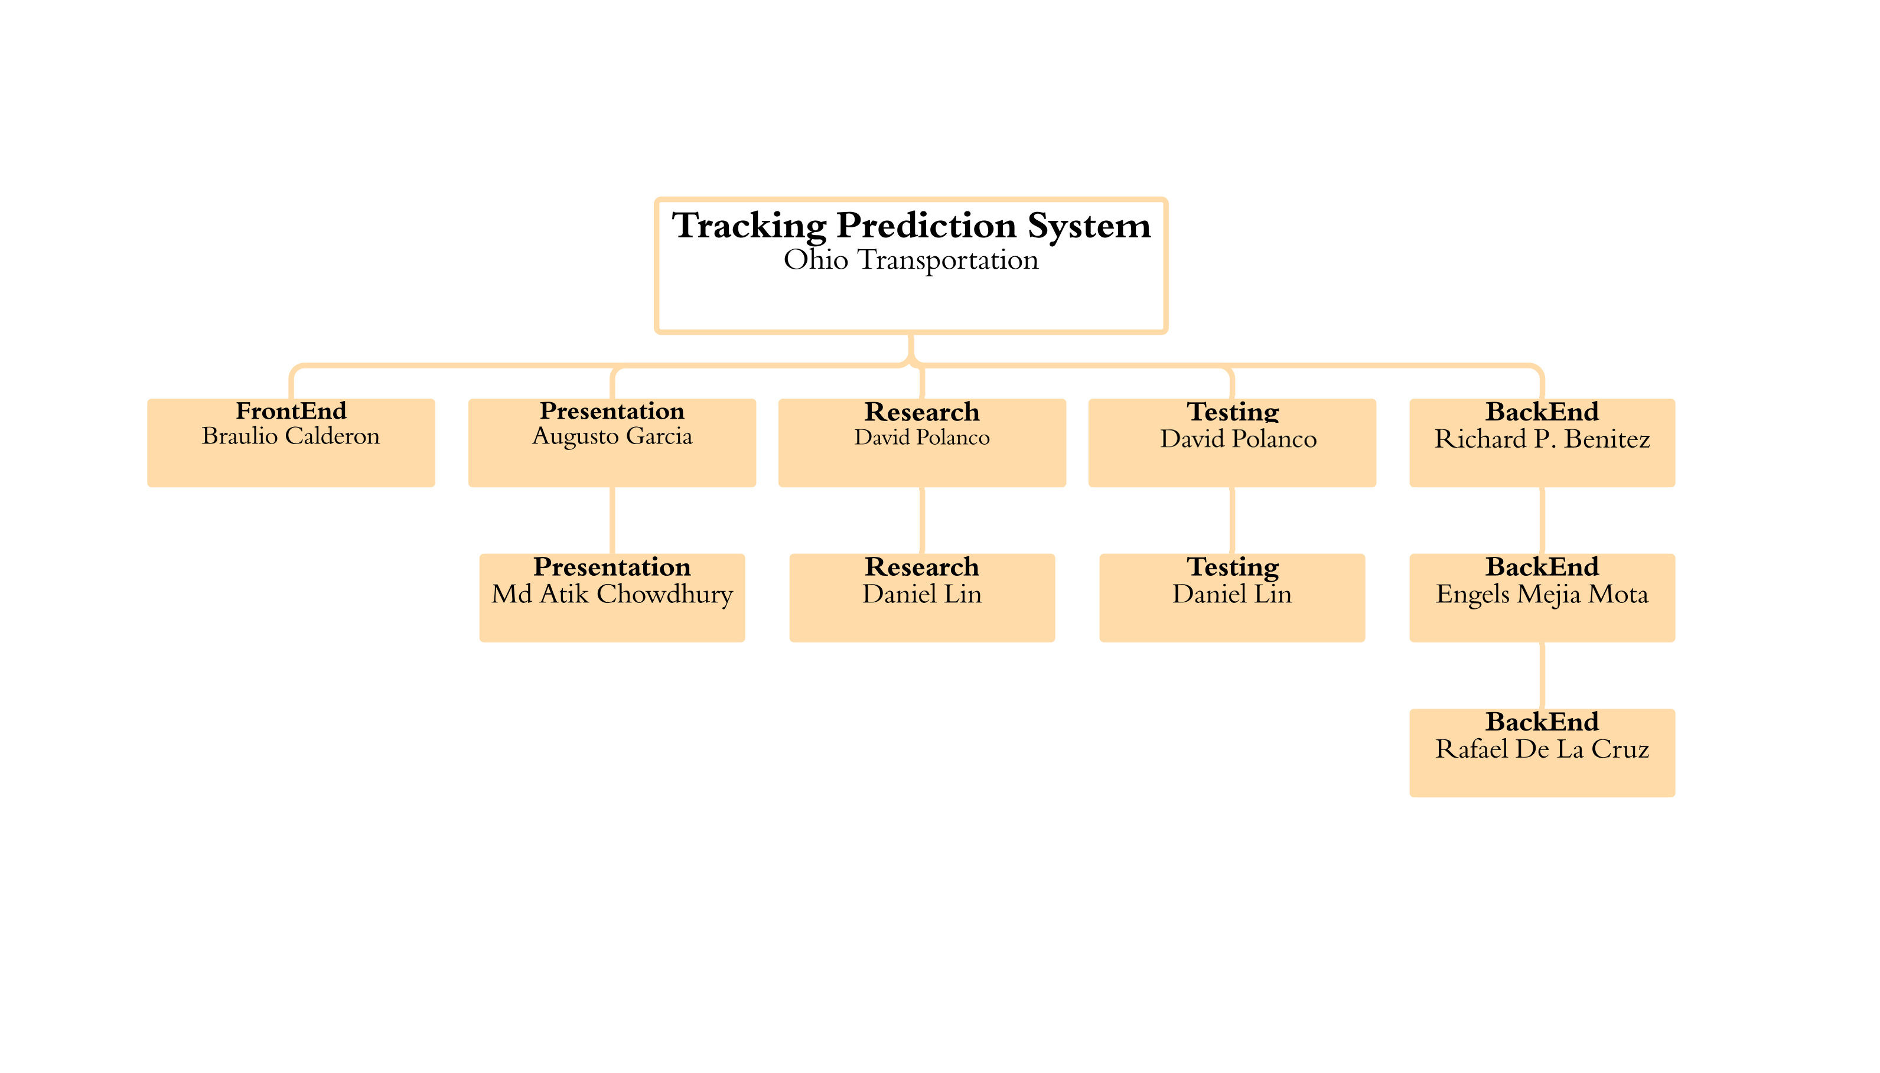
Team 3

Slide 3
Process of Communication
MICROSOFT TEAM
EMAILS
WHATS APP
GITHUB

Slide 4
Technologies
BackEnd
Python
My SQL
Node JS
Database
Firebase
FrontEnd
React

Slide 5
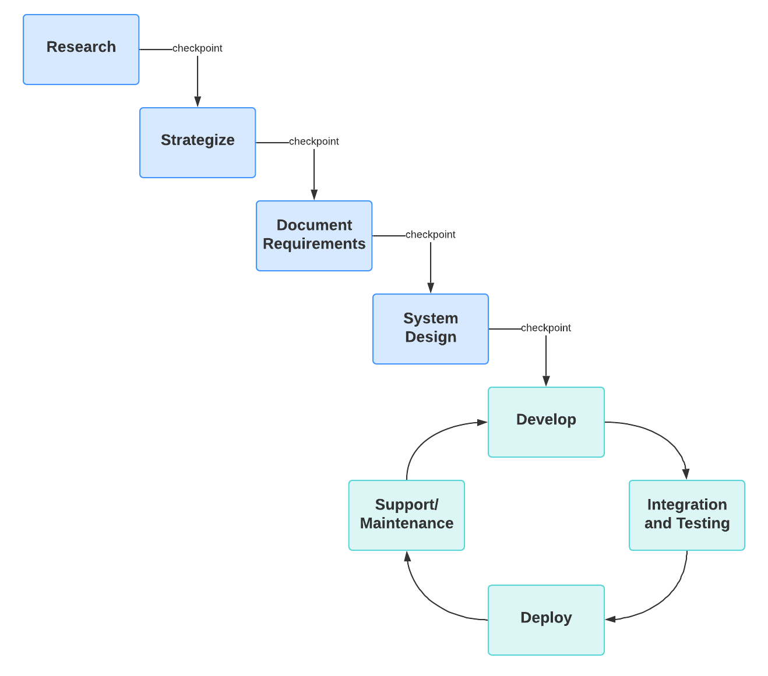
METHODOLOGIES
Agile-waterfall Hybrid Methodology

Slide 6
Requirements
User Requirement
System Requirement
Functional requirement

Slide 7
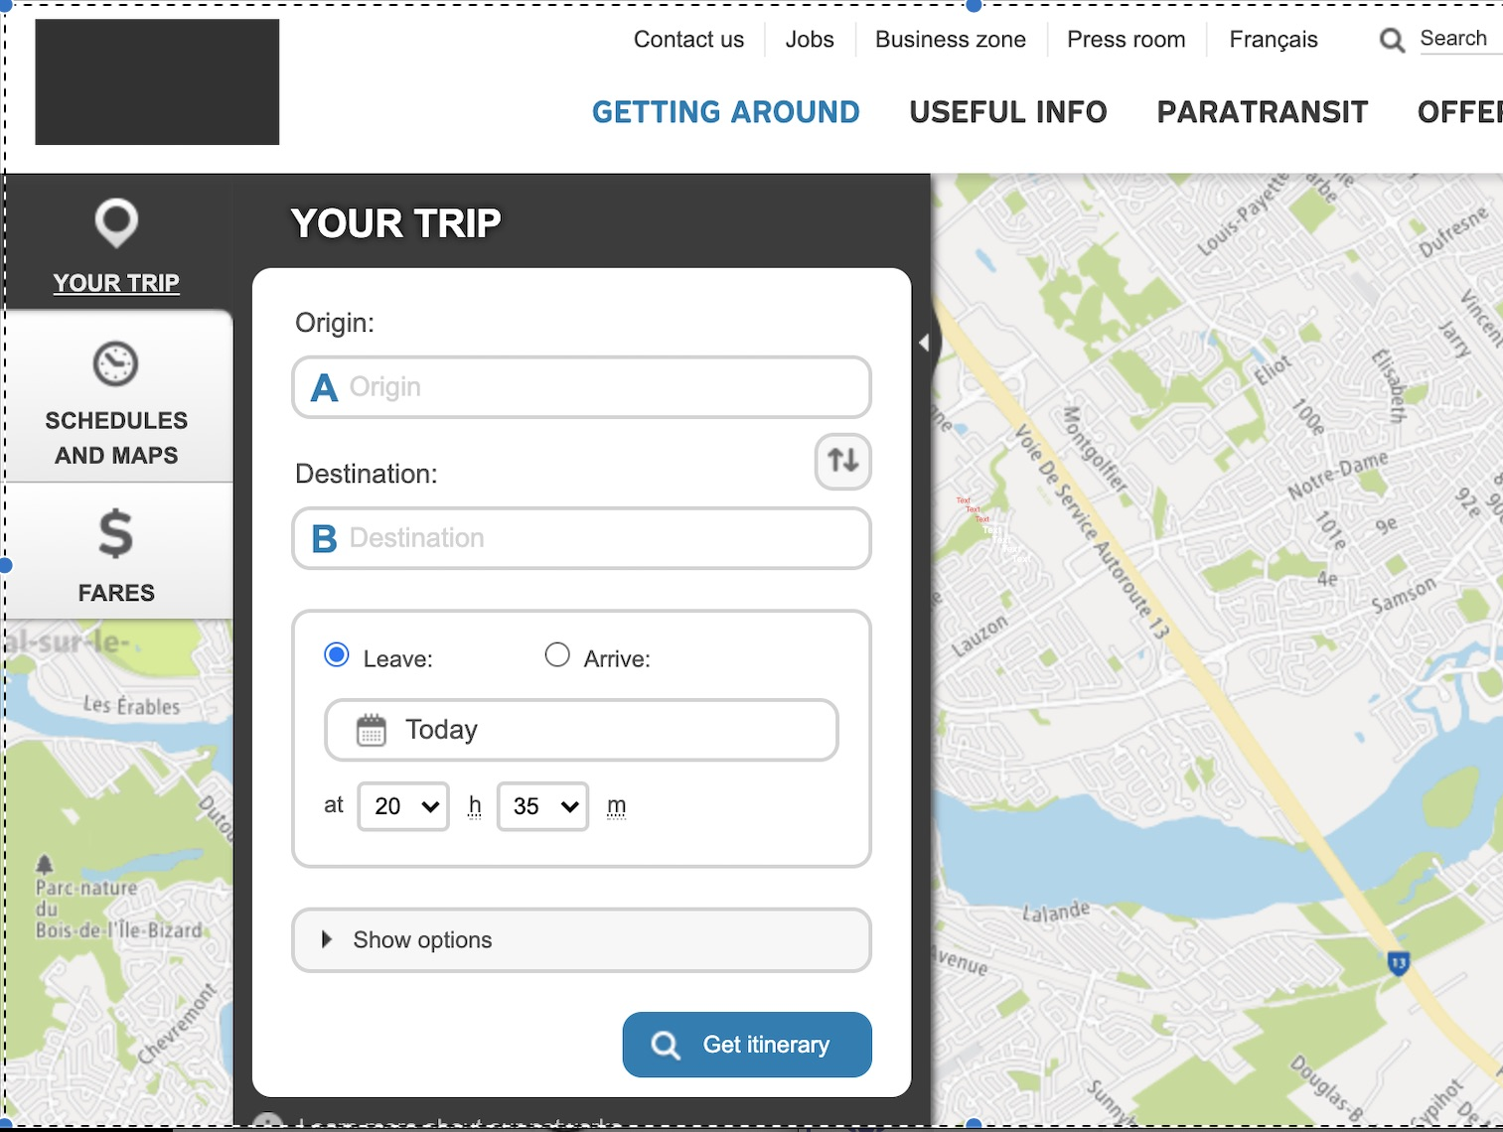
Design

Slide 8
Domain
Customer centric web application in facilitating seamless scheduling between arrivals and departure times in Ohio train stations.

